Slide 1

Project
Sikha Griho
01

Slide 2
It’s not only Classroom,
It’s more than Classroom
Sikka griho Team

Slide 3

Executive Summary
Online classrooms are becoming increasingly prominent in tertiary education. All available evidence point to growing enrolments and provision, although from a low starting point. However, after the hype of the new economy, growing disenchantment with Online classroom has replaced over-enthusiasm.It will boost in covid-19 pandemic. Failures of Online classroom operations have, at least temporarily, overshadowed the prospects of widened and flexible access to tertiary education.
Sikkha griho refers to the use of information and communications technology (ICT) with AI to enhance and/or support learning in tertiary education. While keeping a presiding interest in more advanced applications,

Slide 4

Sikkha griho refers to both wholly online provision and campus-based or other distance based provision supplemented with ICT in some way. The supplementary model encompasses activities ranging from the most basic use of the classroom to more advanced adoption.
First, although student take-up is growing, at most ampus-based institutions enrolments are relatively low and represent a small share of total enrolments. On the available quantitative evidence, provision with “high” online presence In brief, a better knowledge management has become crucial for the advancement of Sikkha griho.

Slide 5
Introduction 8
Project Introduction 9
Team Introduction 11
Background of the Study 12
Project Background 12
Objectives 14
Primary Objective 15
Secondary Objectives 15
Methodology
Process Model
The Project 16
Communication 17
Organization visit/ Survey (One Page for each visit) 17
Stakeholder visit / Communication Client
Planning 28
PERT 31
CPM 32
Gantt Chart / Time Chart 33
Project Planning 20
Software Estimation 21
FP Estimation 24
Process Based estimation

Slide 6
Project Estimation 21
Cost benefit Analysis
Training 26
Risk Analysis
Resource requirements
HR
Others
Modeling 34
Project Features 35
Function Definitions
Function Descriptions
Use Case Diagram 36
Use case Narratives 37
Class Diagram 39
CRC
Sequence Diagram 40
Activity Diagram 45
Swim lane Diagram 47
Collaboration Diagram 48
Data Flow Diagram 49
Process Specification
Control Specification
Architecture Flow Diagram 50
UI/UX design
List Down Entities and Attributes 51
Schema Diagram 54
Normalization 54

Slide 7
Entity Mapping 56
ERD 54
Construction 57
Development Environment 58
Language 58
Testing Strategy 59
Testing techniques 59
Deployment 60
Deployment 61
AMC (Annual Maintenance Contract) 62
Support and Maintenance

Slide 8

INTRODUCTION OF PROJECT
Project Introduction

Slide 9
Project Introduction
Online learning is the newest and most popular form of distance education today. Within the past decade it has had a major impact on postsecondary education and the trend is only increasing.

Slide 10
A virtual classroom is an online learning environment that allows teachers and students to communicate, interact, collaborate, and explain ideas.Today have a lot of virtual classrooms in the world that using for our education, Which provides many facilities in our education system. But I think this virtual classroom doesn't perfect for our educations and students management. So we will create such a virtual classroom that will perfectly handle university Teachers and students that very needs our education system.So we will create such a virtual classroom that will perfectly handle university Teachers and students that very needs our education system.

Slide 11




Team Introduction
Md. Kaiyom
Nabendu Bikash Binda
Md. Sumon Hosen
Afzal Hossain
mamber
member
member
member

Slide 12
Background of the Study
Project Background

Slide 13

A growing number of students are now opting for online classes. They find the traditional classroom modality restrictive, inflexible, and impractical. In this age of technological advancement, schools can now provide effective classroom teaching via the Web. This shift in pedagogical medium is forcing academic institutions to rethink how they want to deliver their course content. The overarching purpose of this research was to determine which teaching method proved more effective over the 8-year period. The scores of 548 students, 401 traditional students and 147 online students, in an environmental science class were used to determine which instructional modality generated better student performance. In addition to the overarching objective, we also examined score variabilities between genders and classifications to determine if teaching modality had a greater impact on specific groups. No significant difference in student performance between online and face-to-face (F2F) learners overall, with respect to gender, or with respect to class rank were found. These data demonstrate the ability to similarly translate environmental science concepts for non-STEM majors in both traditional and online platforms irrespective of gender or class rank. But when a student or teacher will go to a online classroom platform he or she did not get fully proper fill. For that reason we will try to fulfilled all their wants and needs.

Slide 14
Objective
Project objective

Slide 15
primary
Secondary
Enhance the quality of learning and teaching. Meet the learning style or needs of students. Improve the efficiency and effectiveness. Improve user-accessibility and time flexibility to engage learners in the learning process
Bring every student and teacher in a same platform

Slide 16

THE PROJECT___
Project Planning

Slide 17
Survey
We create a survey for this project:
Here the link is-https://docs.google.com/spreadsheets/d/1btLmdqC-ikddEPXm8oJM3x78CweSmfc9RMvrm6eLggk/edit?usp=sharing

Slide 18


Slide 19

▸ As it is a virtual system, we can reach any person at any place without any extra expense.
▸ Bring innovation through new technologies,
It is trustworthy from a teacher stand point and in the long run it is beneficial for students also.
▸ It has some extended features that are not found on any other platform.
▸ Customers will be loyal to the company because of the good quality products and services.
▸ As the system is virtual, the system is susceptible to the internet and network quality.
▸ There are two sides to each coin. So, along with positive reviews, there are also negative reviews by many users who are not satisfied with the service.
▸ Because of its virtual nature there is no way to interact with people or understand users/students emotions.
A more cost effective model is critical.
Strength
Weakness
Opportunities
Threats
▸ With the increase of internet users in Bangladesh, the trend of virtual education has also increased over the last few years.
▸ Professional/premium courses and certifications.
▸ Only tapped nearly 5% of students.
▸ The education sector has been adversely affected due to Covid-19. It will be give a great opportunity our education sectors that will more increase online education
▸ Data privacy
▸ Government regulations
▸ Not available digital devices to participate.

Slide 20


Project Sikha Griho
Project Planning Vision: To give every school and college a secure integrated software. Which can fill every teacher and student all class, exam, and study related work.
Audience: College, University, school, and all students.
The risk to be included: The main risk is if we failed to collect proper funding this is so tough to maintain this project.
Timeline: If we give 3 month to develop backend, 2 month for develop database, 2 month for setup system, 1 month for testing 1 month in other then total 8 month needed to published this project.

Slide 21

Team building:
Backend development : kaiyom ahmed, Nabendu Bikash Binda.
Database maintenance with development: Sumon Ahmed, Afzal hossain.
Fund collection: Afzal hossain, Nabendu Bikash Binda
Security establishment: Kaiyom ahmed,
Marketing : marketing team.
Software Estimation:
Now we will estimate the size, effort and schedule from the requirements or feature list of the project. After that we will compare this estimate with the actual size, effort and schedule. In this way we will show the reader that how the estimation work and how you can compare it after you have completed the project.

Slide 22
SIZE for Project A
As discussed earlier I have used function points for estimating the size. Briefly Project A is a data acquisition and processing software. It displays acquired data on the screen.
In function points estimation we have to take into accounts all external inputs, external outputs, internal logical files, external interface file and external queries. Now for project
External Inputs | Complexity
Data Stream | High
Configuration files | Medium
User Selection | Medium
User Input | High

Slide 23
As you can see each parameter is assigned a complexity value which is either high, low or medium. One can give this value by determining the complexity that will be tackle when writing the code for that particular parameter. Similarly we estimate the external output
Internal Logical Files | Complexity
Storage file | High
Intermediate buffer | High
Intermediate Result | Medium
Channel Files | Medium

Slide 24
Function Point Estimation-
Sikha Griho Management System
Information Domain Characteristics
Count
Weighting Factor
E st. Count
FP Count
Optimistic
Most Likely
Pessimistic
Number of External Input (EI)
15
25
35
4
25
100
Number Of External Output (OI)
17
19
23
5
19
97
Number Of External requers (EO)
20
23
25
3
23
68
Number Of Internal Files (ILF)
10
12
15
6
12
73
Number Of External Interface (ILF)
8
10
13
7
10
71
Count Total = 409
UFP = 409

Slide 25
VAF = [ 0.65 + 0.01 * ( Fi) ]
= [ 0.65 + 0.65 * 41 ]
= 1.06
FP estimated (w) = Count total * [VAF]
= 409 * 1.06
= 433.54
= 434 [Aproxe]
Average Productivity X= 6.09 FP / PM
Per employee average salary Y= 12000 per month
Cast per FP ‘Z’ = X/Y = 12000 / 6.9
= 1740 [Aproxe]
Total estimate project cost = W * Z
= 434 * 1740
= 755160 [Aproxe]
Estimated Effort = W / X
= 434 / 6.9
= 63 [Aproxe]

Slide 26
Training-
Angular framework learning short training- duration 3 weak
Microservice training- duration 1 weak

Slide 27
Resource Requirement -
ML engineer- 2
C++ expert - 2
Java expert - 4
Hr. manager-1
Marketing executive-4
Office stuff- 2
Database engineer - 2
Frontend developer-4
Backend developer - 8

Slide 28
PLANNING__

Slide 29
# | Work | Time (week) | Dependency
A | Collect starting capital | 12
B | Buy necessary hardware (like computer ) | 1 | A
C | Environment Setup | 3 | B
D | Modify design pattern | 2 | B
E | Software planning | 4 | C,D
F | Define requirement | 2 | E
G | Design prototype | 18 | F

Slide 30
# | Work | Time (week) | Dependency
H | Develop Software | 24 | G
I | Software Testing with fixing bug | 15 | H
J | Deployment | 1 | I
K | Release beta version android | 30 | J
L | Development, fixing and update bug | 24 | K
M | Release final version | 3 | L
N | Deployment | 3 | M

Slide 31
PART - Critical Path Method
A
B
C
F
G
H
I
J
D
E
M
L
K

Slide 32
CPM - Critical Path Method
0
A
12
12
B
13
13
C
16
16
E
20
20
F
22
FP=0
0
12
12
12
1
13
13
3
16
16
4
20
20
2
22
FP=0
FP=0
FP=0
FP=0
FP=0
13
D
15
22
G
40
FP=0
14
2
16
22
18
40
137
N
140
FP=1
137
3
140
40
H
64
FP=0
FP=0
40
24
64
134
M
137
134
12
137
64
I
79
FP=0
FP=0
FP=0
64
64
79
110
L
134
80
K
110
79
J
80
110
24
134
80
30
110
79
1
80

Slide 33
GANTT Chart
We implement that in google sheet here the sheet link-
PLEASE CLICK HERE TO SEE GANTT CHART

Slide 34
MODELING___
Project modeling

Slide 35
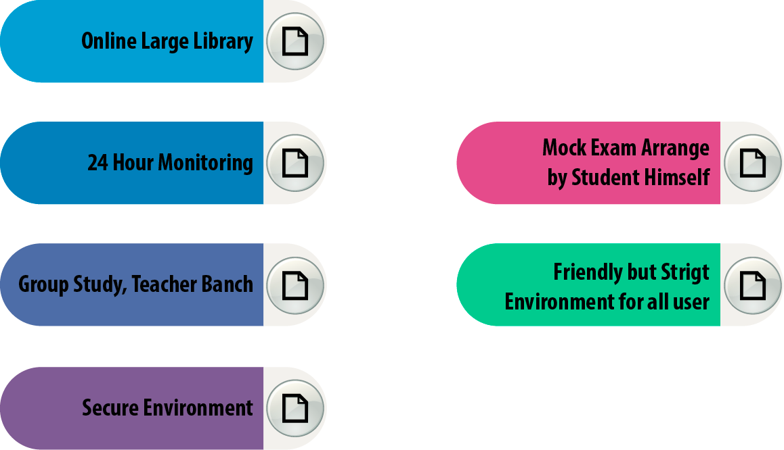
Project Features

Slide 36
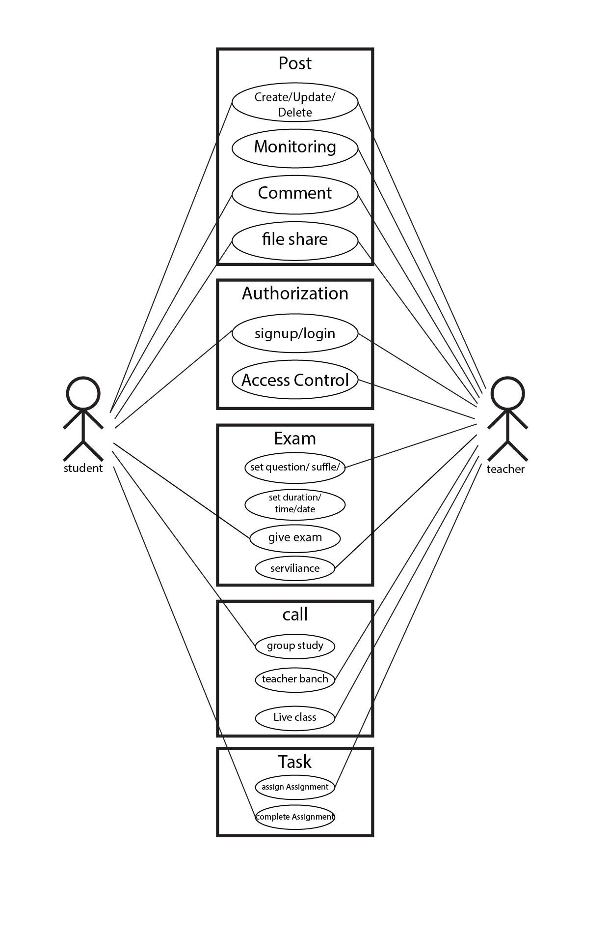
Use Case Diagram

Slide 37
Use Case Narrative
Post Create/Update/Delete : Teachers and Student both can create post in the classroom and they can post update and delete.
Monitoring : Teachers will be able to monitor every student during the exam time. If the teacher has feel any doubt then the teacher can open the student device camera.
File Share & Comment : Teachers and Students can share file in their Computer and Teachers and students will be able to comment for post.
Authorization : The University can specifying access rights who use this classrooms and classroom features. Classrooms at first provide a user login and register dashboard.

Slide 38
Use Case Narrative
Exam : Teachers can set some rules for examinations in this classrooms. The classroom provide lot of features like-
Set Questions for group or individual students.
Set Durations and time and date
Questions and Answers upload options
Call : This classrooms provide call features and use for-
Live Classes
Group Study
Teacher Banch
Task : Task features provide assignment options for student. The teachers can assign assignments with dateline for students in the classroom.

Slide 39
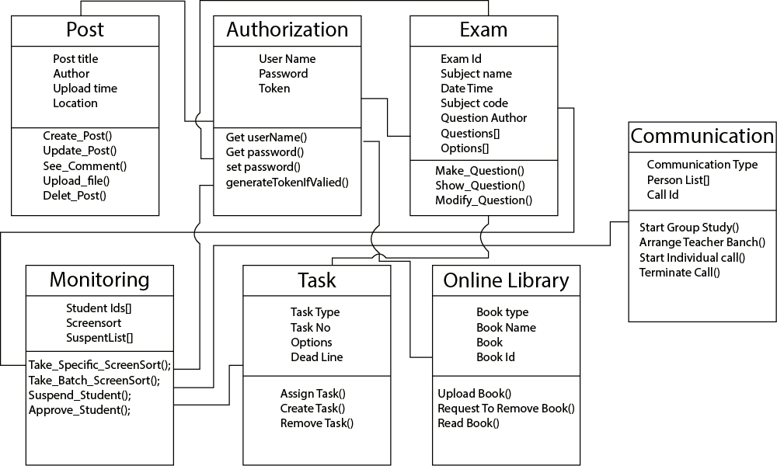
CLASS DIAGRAM

Slide 40
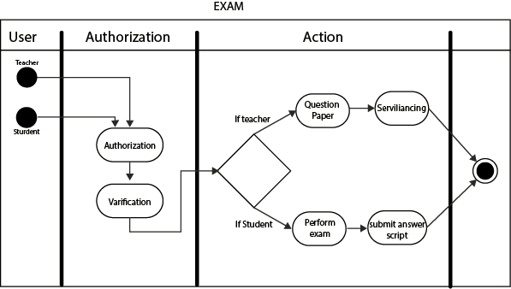
SEQUENCE DIAGRAM
Authorization & Exam:-

Slide 41
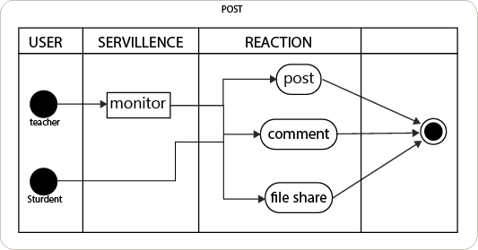
SEQUENCE DIAGRAM
Post:-

Slide 42
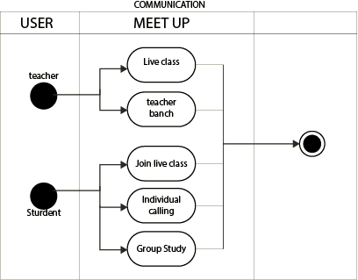
SEQUENCE DIAGRAM
Communication:-

Slide 43
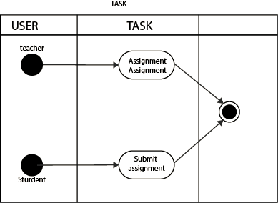
SEQUENCE DIAGRAM
Task:-

Slide 44
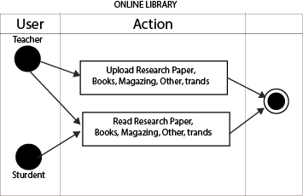
SEQUENCE DIAGRAM
Online Library:-

Slide 45
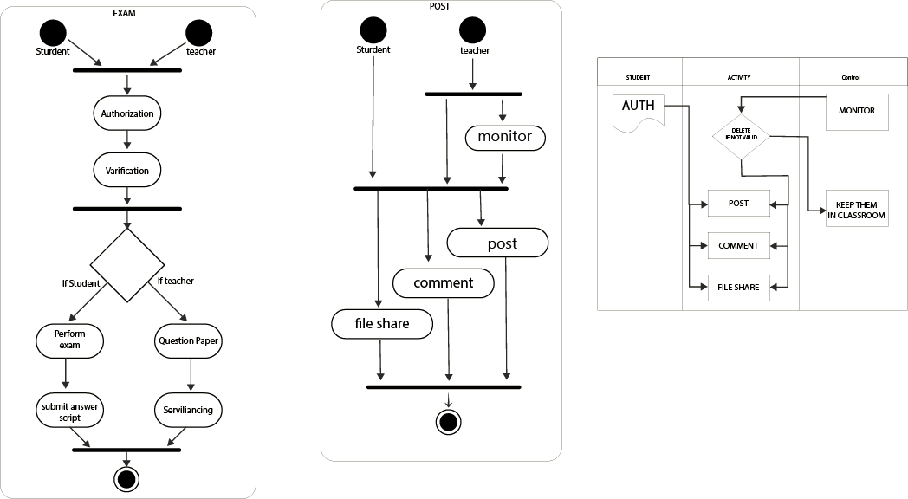
ACTIVITY DIAGRAM

Slide 46
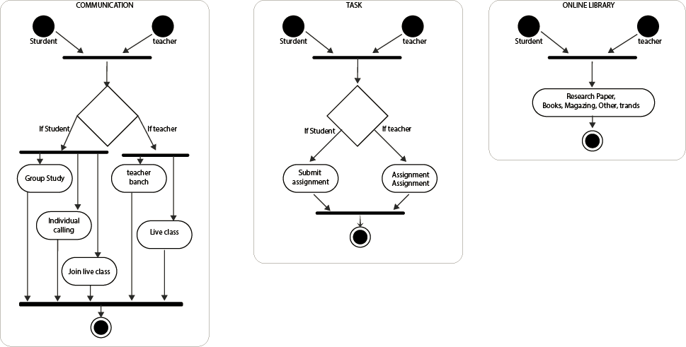
ACTIVITY DIAGRAM

Slide 47
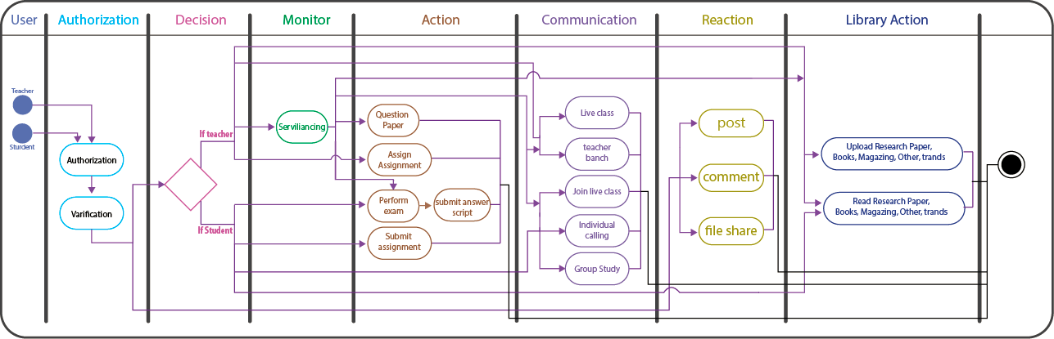
SWIMLANE DIAGRAM

Slide 48
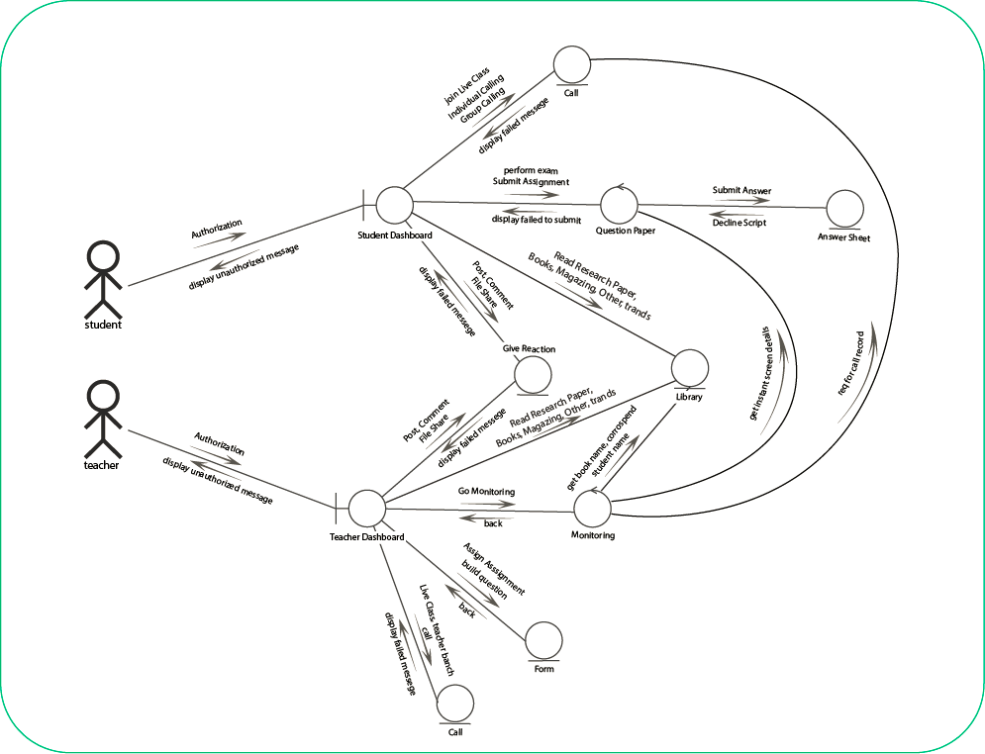
COLLABORATION DIAGRAM

Slide 49
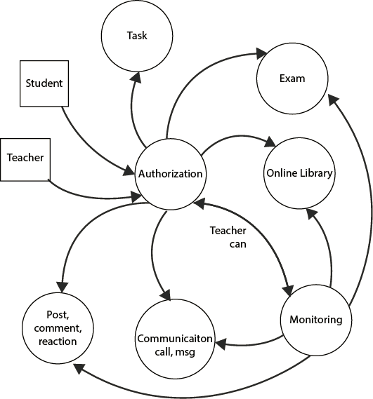
Data Flow Diagram

Slide 50
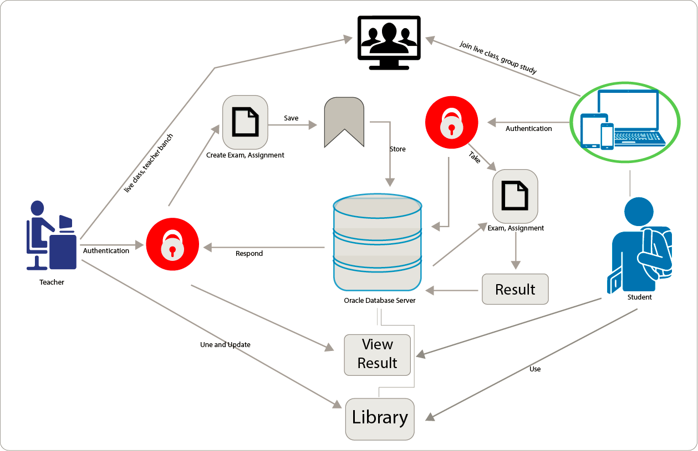
ARCHITECTURE FLOW DIAGRAM

Slide 51
List of Entities and attributes
Entity= BaseUser
Attribute= NID, User Name, Father Name, Mother Name, Gender, Contact No, Email, DoB, Address,
Admin Approval, Role, Password
Entity= Student
Attribute= Std Id, Dept Id, Batch, Semester
Entity= Teacher
Attribute= Teacher Id, Educational Qualification, Expertise
Entity= Department
Attribute= Dept Id, Dept Name
Entity= Courses
Attribute= Code, Department Id, Course Name, Teacher Id, Course Current Semester

Slide 52
List of Entities and attributes
Entity= Request Course
Attribute= Request Course, Student Id, Course code, Dept Id
Entity= Exam Paper
Attribute= Exam Id, Course Id, Teacher Id, Percentage Value, Starting Date Time, Ending Date Time,
Course Session, Total, Publisher
Entity= Question or assignment
Attribute= Exam Id, Question No, Question, Question Image, Mark
Entity= Student Mark
Attribute= Student id, Dept Id, Course Code, Exam Id, Got Total Marks, Review
Entity = Library
Attribute = Book id, Book name, Collected By

Slide 53
List of Entities and attributes
Entity= Question Answer
Attribute= Exam Id, Question No, Option No, Option Value, Answer Status
Entity= Result
Attribute= Student Id, Course Code, Dept Id, Course Session, CGPA, Grade, Semester, Previous Semester, Course
Entity= Student Answer Script
Attribute= Student Id, Exam Id, Question No, Option No, Answer Status

Slide 54
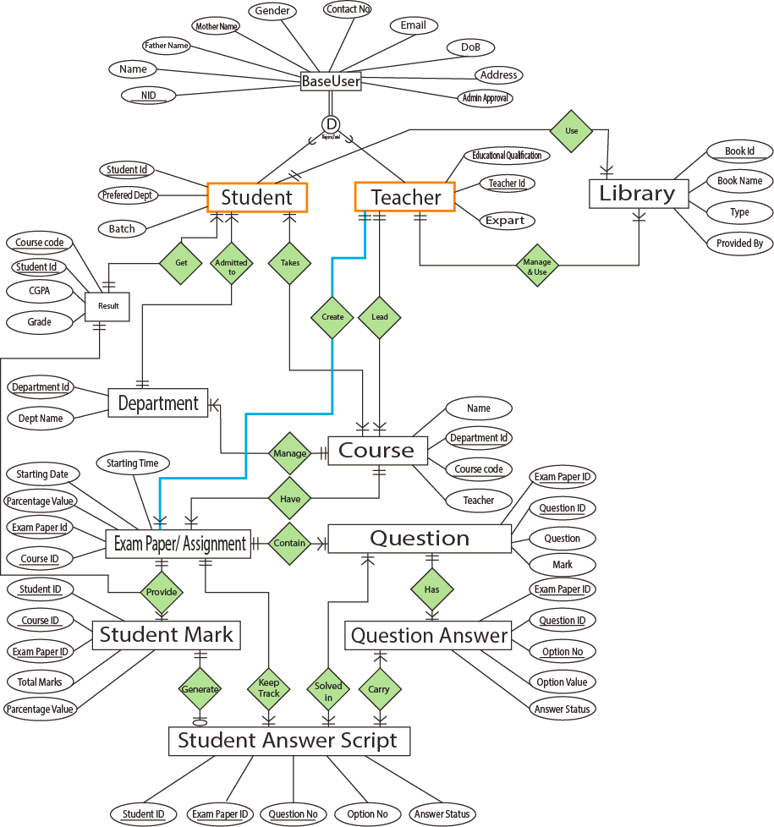
SCHEMA & ERD DIAGRAM
ALFA VERSION:

Slide 55
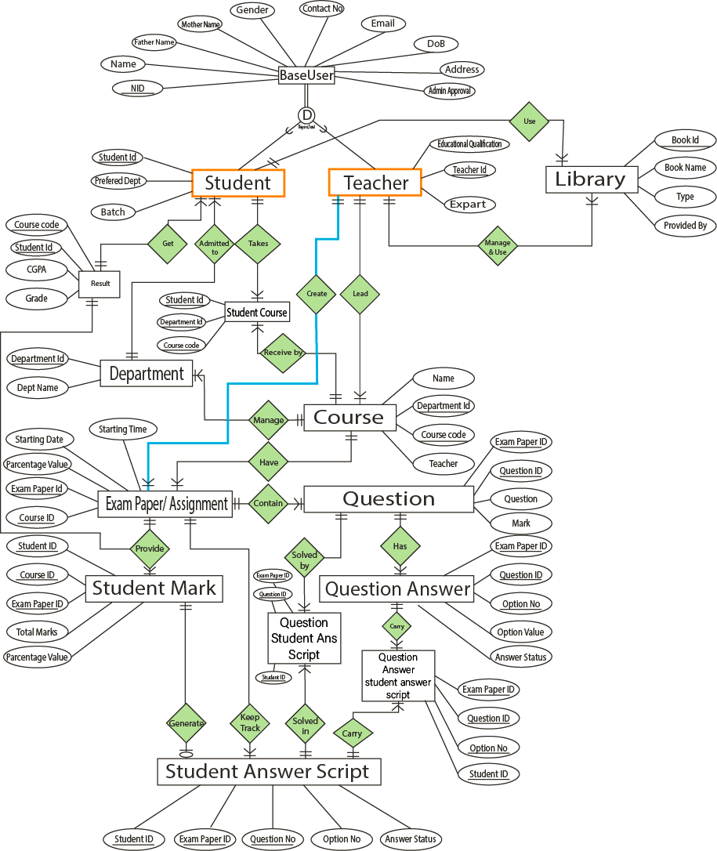
NORMALIZATION
ALFA VERSION:

Slide 56
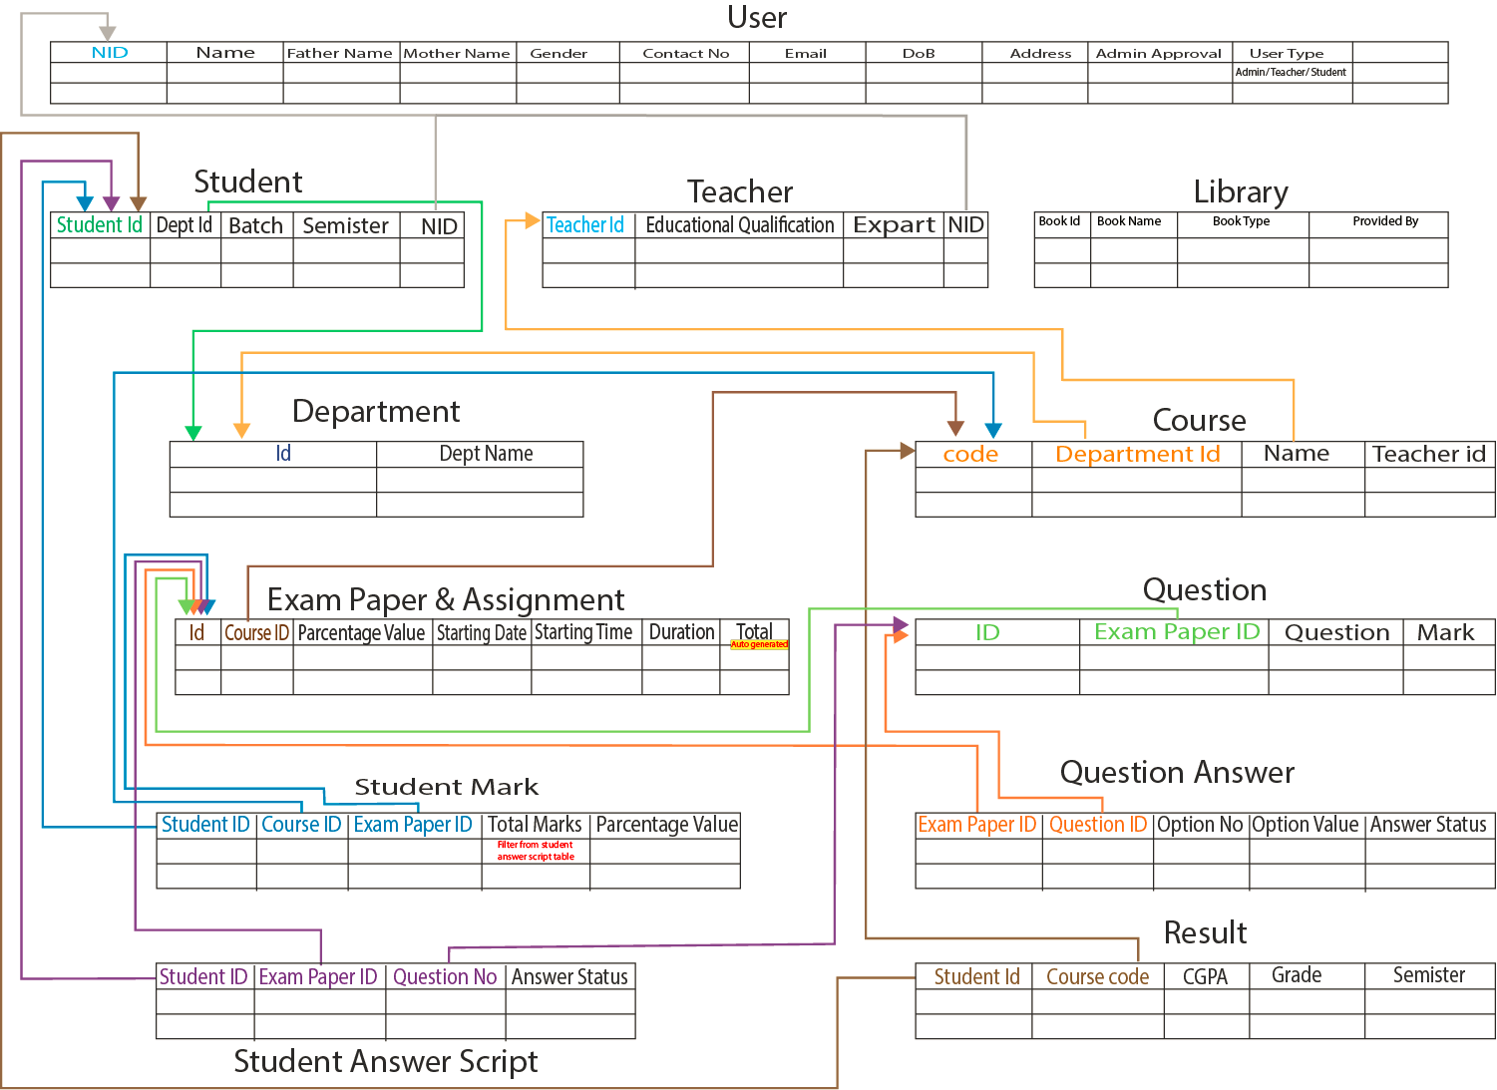
ENTITY MAPPING
ALFA VERSION:

Slide 57

CONSTRUCTION___
Project Building

Slide 58
DEVELOPMENT ENVIRONMENT
LANGUAGE:
PROGRAMMING LANGUAGE:JAVA, C++
QUERY LANGUAGE: ORACLE MYSQL
FRONT DESIGN : ANGULAR (JAVASCRIPT FRAMEWORK)
IDE:
INTELLIJ & eclipse FOR JAVA, ANDROID STUDIO

Slide 59
TESTING STRATEGY: Unit testing, System testing
TESTING TECHNIQUE: (JUNIT, POSTMAN, VISUAL VM)
BLACK BOX TESTING (MUTATION TESTING, BOUNDARY VALUE ANALYSIS, WORST CASE TESTING)
WHITE BOX TESTING (BASIC PATH TESTING)
UNIT TESTING.

Slide 60

DEPLOYMENT___
Project Release

Slide 61
DEPLOYMENT PHASE
Source Code
(Java, SQL, XML, HTML, CSS)
Version Control System
(Git, Github, Bitbucket, Gitlab)
Cloud Infrastructure
(AWS, GCP, Digital Ocean)

Slide 62
Annual Maintenance Contract with Support
We implement an agreement in google doc. The doc link -
PLEASE CLICK HERE TO SEE AMC

Slide 63
Thank you!
Write a closing statement or call-to-action here.

